Slide 1
How does a plant gain mass?
Your ideas
Your questions
Notes:
Poster for Lesson 1, Activity 2: Students’ initial ideas about

Slide 2
Class Data for Plant Growth Investigation (Pre-Lesson and Lesson 1)
Group | Vermiculite Start Mass | Vermiculite End Mass | Vermiculite Mass Change | Plant Start Mass | Plant End Mass | Plant Mass Change | Total Change in Mass
1
2
3
4
5
6
7
Average

Slide 3
Plant Growth Investigation Sample Data
Trial # | initial mass of vermiculite (g) | initial mass of seeds(g) | final dry mass of vermiculite (g) | final dry mass of plants (g) | change in mass of vermiculite (g) | change in mass of plant material (g)
1 | 32.44 | 0.07 | 32.3 | 0.90 | -0.14 | 0.83
2 | 33.63 | 0.06 | 33.3 | 1.10 | -0.33 | 1.04
3 | 32.78 | 0.06 | 32.6 | 1.20 | -0.18 | 1.14
4 | 32.51 | 0.05 | 32.3 | 1.10 | -0.21 | 1.05
5 | 33.14 | 0.06 | 32.6 | 1.60 | -0.54 | 1.54
6 | 32.13 | 0.05 | 32 | 0.80 | -0.13 | 0.75
Average |  |  |  |  | -0.26 | 1.06

Slide 4
Sample Data

Slide 5
What happens when a plant grows?
Where are atoms moving from?
Where are atoms moving to?
Chemical change
What molecules are carbon atoms in before the change? What other molecules are involved?
What molecules are carbon atoms in after the change? What other molecules are involved?
Remember: Atoms last forever (so you can rearrange atoms into new molecules, but can’t add or subtract atoms)
Notes:
Teaser process tool (minus energy)

Slide 6
How does a plant gain mass?
Where are atoms moving from?
Where are atoms moving to?
Chemical change
What molecules are carbon atoms in before the change? What other molecules are involved?
What molecules are carbon atoms in after the change? What other molecules are produced?
What forms of energy are in the reactants?
What forms of energy are in the products?
Remember: Atoms last forever (so you can rearrange atoms into new molecules, but can’t add or subtract atoms) Energy lasts forever (so you can change forms of energy, but energy units can’t appear or go away)
Notes:
Teaser process tool for all investigations except soda water

Slide 7
Class Data for What is Photosynthesis Activity (Lesson 2)
Aquatic Plants in the Light |  |  |  | Observations of Color Change | Conclusions based on Observations (What happened?)
Test Tube With Plant |  | Control
Start BTB Color | End BTB Color | Start BTB Color | End BTB Color
Yellow |  | Yellow
Yellow |  | Yellow
Yellow |  | Yellow
Yellow |  | Yellow
Yellow |  | Yellow
Yellow |  | Yellow
Yellow |  | Yellow

Slide 8
Class Data for What is Respiration Activity (Lesson 4)
Aquatic Plants in the Dark |  |  |  | Observations of Color Change | Conclusions based on Observations (What happened?)
Test Tube With Plant |  | Control
Start BTB Color | End BTB Color | Start BTB Color | End BTB Color
Blue |  | Blue
Blue |  | Blue
Blue |  | Blue
Blue |  | Blue
Blue |  | Blue
Blue |  | Blue
Blue |  | Blue

Slide 9
Process Tool for Molecular Models Start by making the molecules and energy units of the reactants and putting them on the reactants side, then rearrange the atoms and energy units to show the products.
Chemical change
Reactants
Products
Remember: Atoms last forever (so you can rearrange atoms into new molecules, but can’t add or subtract atoms)
Energy lasts forever (so you can change forms of energy, but energy units can’t appear or go away)

Slide 10
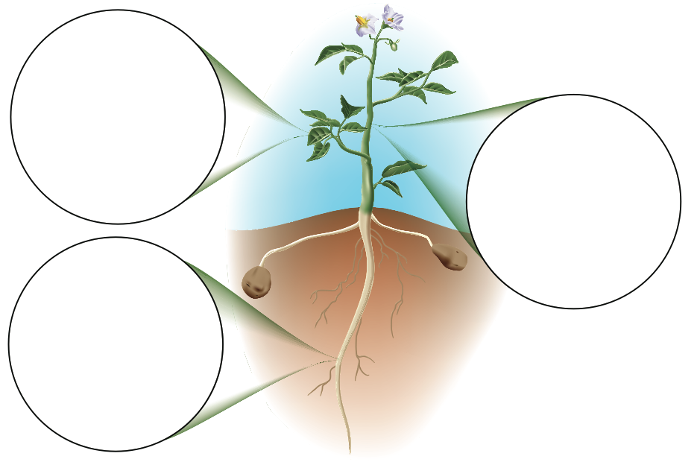

Slide 11
How does a plant gain mass?
The possibilities are soil nutrients, water, and air. How many of these do they list? In particular, how many students include air as a possibility?
Students should identify the plant and possibly its parts: leaves, stem, roots.
Where are atoms moving from?
Where are atoms moving to?
Do students recognize that this investigation gives them no evidence to help answer this question? How many students list CO₂ as a possible carbon source? Do they mention other possibilities such as nutrients in the soil?
How many students recognize that plants are made of organic matter (from the Systems and Scale unit)? Do they remember that organic matter contains carbon?
Chemical change
What molecules are carbon atoms in before the change? What other molecules are involved?
What molecules are carbon atoms in after the change? What other molecules are produced?
Many students will correctly list sunlight. How many students incorrectly list other sources? (You do not need to correct their ideas at this point; just note them so that you can come back to them in Lesson 2).
Look for evidence about how well students are following the rules for energy? In particular, do they distinguish between chemical energy in C-C and C-H bonds and organic materials such as glucose that contain energy but are not forms of energy?
What forms of energy are in the reactants?
What forms of energy are in the products?
Remember: Atoms last forever (so you can rearrange atoms into new molecules, but can’t add or subtract atoms) Energy lasts forever (so you can change forms of energy, but energy units can’t appear or go away)
Notes:
Teaser process tool for all investigations except soda water

